Slide 1
Computer Modeling and Simulation
Lecture 6

Slide 2
Drug dosage Model
Errors in the dispensing and administration of medications occur frequently. Although most do not result in great harm, some do.
There are prescribed dosages for various drugs, but how do we determine what the correct/effective dosage is?
Metabolism of a drug in the human body is a complex system to represent in a model. Thus, in Step 2 of the modeling process, particularly for our first attempt, we should make simplifying assumptions about the drug and the body.
A one-compartment model is a simplified representation of how a body processes a drug.

Slide 3
One-Compartment model
In this model, we consider the body to be one homogeneous compartment, where distribution is instantaneous, the concentration of the drug in the system (amount of drug/volume of blood) is proportional to the drug dosage, and the rate of elimination is proportional to the amount of drug in the system.
The concentration of a drug instead of the absolute quantity is important because a quantity that might be appropriate for a small child could be ineffective for a large adult.

Slide 4
One-Compartment model
A drug has a minimum effective concentration (MEC), which is the least amount of drug that is helpful, and a maximum therapeutic concentration, or minimum toxic concentration (MTC), which is the largest amount that is helpful without having dangerous or intolerable side effects.
The therapeutic range for a drug consists of concentrations between the MEC and MTC.
A drug’s half-life, or the amount of time for half the drug to be eliminated from the system, is useful for modeling as well as patient treatment.
Often concentrations and half-life are expressed in relationship to the drug in the plasma or blood serum.

Slide 5
One-Compartment model
To compute aspirin’s plasma concentration (plasma_concentration) in a converter (variable), we have another converter for the volume of the system (plasma_volume) with a value of 3000 mL and appropriate connectors and equation.

Slide 6
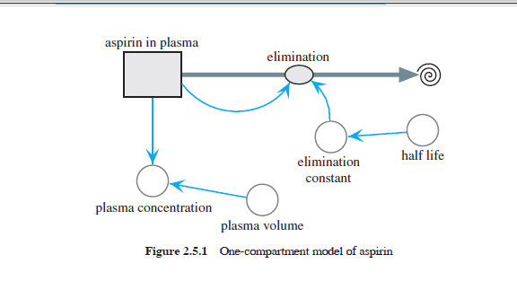

Slide 7
Equations Set for one compartment drug dosage model
half_life = 3.2 h
plasma_volume = 3000 mL
aspirin_in_plasma(0) = 2 * 325 * 1000 μg
elimination_constant = –ln(0.5)/half_life
elimination = elimination_constant * aspirin_in_plasma
plasma_concentration = aspirin_in_plasma/plasma_volume

Slide 8
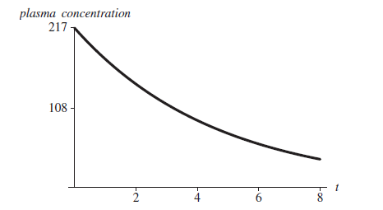
Graph of plasma_concentration (μg/mL) for aspirin versus time, t (h)

Slide 9
One-Compartment Model of Repeated Doses
We model the concentration in the body of the drug Dilantin, a treatment for epilepsy that the patient takes on a regular basis.
Adult dosage is often one 100-mg capsule three times daily.
The half-life of Dilantin ranges from 7 to 42 h but averages 22 h.
For simplicity, we assume a one-compartment model with instantaneous absorption.

Slide 10
One-Compartment Model of Repeated Doses
A stock (box variable), drug_in_system, represents the mass of Dilantin in the compartment, which is the person’s blood serum.
A flow, ingested, into drug_in_system is for the drug absorbed into the system. Because of the periodic nature of the dosage, we employ a pulse function with converters/variables for the dose (dosage), time of the initial dose (start), and time interval between doses (interval).
Presuming that only a fraction (absorption_fraction) actually enters the system, we multiply this constant (say, 0.12, from experimental evidence) and the pulse value together for the equation of entering.
We can estimate the value of absorption_fraction by plotting actual data of drug concentration versus time and employing techniques of curve fitting.

Slide 11
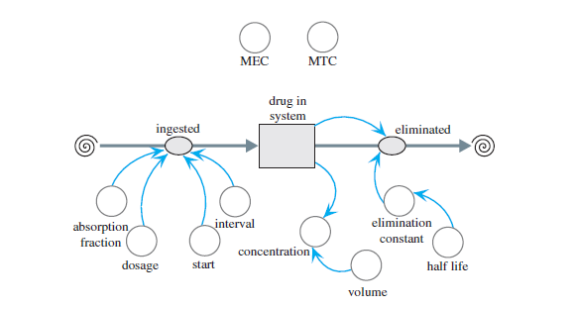
One-compartment model of Dilantin
One-compartment model of Dilantin

Slide 12
Equation set for repeated doses in single compartment model
half_life = 22 h;
start = 0 h; interval = 8 h;
MEC = 10 μg/mL; MTC = 20 μg/mL;
volume = 3000 mL; dosage = 100 * 1000 μg;
absorption_fraction = 0.12
elimination_constant = –ln(0.5)/half_life
drug_in_system(0) = 0
entering = absorption_fraction * (pulse of amount dosage beginning at start
every interval hours)
elimination = elimination_constant * drug_in_system
concentration = drug_in_system

Slide 13
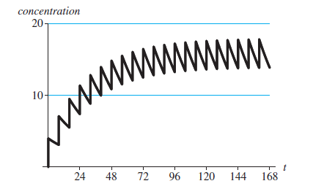
Graph of concentration of repeated doses vs time
Graph of concentrations MEC = 10 μg/mL, MTC = 20 μg/mL, and concentration
(μg/mL) versus time (h)

Slide 14
Mathematics of repeated doses model
Why the drug concentration in the Dilantin example tends to a fixed value, in this case about 12 μg/mL, immediately after a dose.
Suppose that the patient takes a 100-mg tablet every 8 h. In the model, we assumed an absorption level of 0.12, so that the effective dosage is Q0 = (0.12)(100) = 12 mg.
With an elimination rate of –ln(0.5)/22, which is about 0.0315, the amount of drug in the system after 8 h is
Q = Q₀e^{-0.0315(8)} ≈ (12)(0.7772) = 9.3264 mg = 9326.4 μg.
Thus, at the end of 8 h, about 77.72% of the drug remains in the system.
Suppose Q_{n} is the quantity (in mg) in the system immediately after the nth tablet

Slide 15
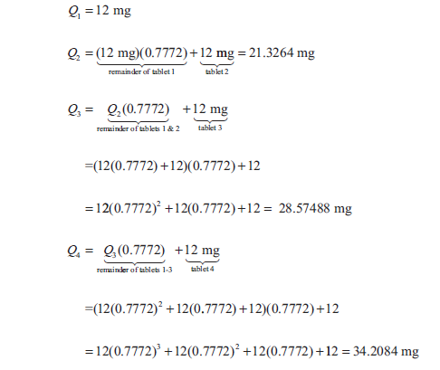
Mathematics of repeated doses model
Thus, assuming 77.72% of the drug remains in the system at the end of an 8-h interval immediately before a dose, we have the following:

Slide 16

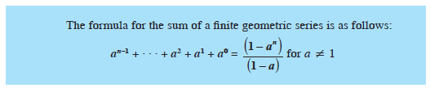
Mathematics of repeated doses model
Similarly, the quantity of the drug immediately after the nth tablet, Qn, follows:

Slide 17
Two-compartment model
The one-compartment model is more appropriate for an injection of a drug into the system than for a pill, which takes time to dissolve, be absorbed, and be distributed within the system.
In such cases, a two-compartment model might yield better results.
The first compartment represents the digestive system (stomach and/or intestines), while the second might indicate the blood, plasma, serum, or a particular organ that the drug targets. A flow pumps the drug from one compartment to the other in the model.
One option for modeling the rate of change of absorption from the intestines to blood serum has the rate proportional to the amount of drug in the intestines.
Probably a more accurate representation has the rate of change of absorption from the intestines to blood serum be proportional to the volume of the intestines and to the difference of the drug concentrations in the intestines and serum.
Although the one- or two-compartment model is appropriate for most situations, a drug dosage problem could benefit from more compartments in a multicompartment model

Slide 18
Force and Motion
We want to model skydiving now.
For that we model velocity and acceleration first.
The instantaneous rate of change, or derivative, of position (s) with respect to time (t) is velocity (v).
Moreover, the instantaneous rate of change of velocity with respect to time is acceleration (a). In derivative notation, we have the following:
We use these derivatives in modeling the motion of a ball when, on a windless day, someone standing on a bridge holds a ball over the side and tosses the ball straight up into the air.

Slide 19
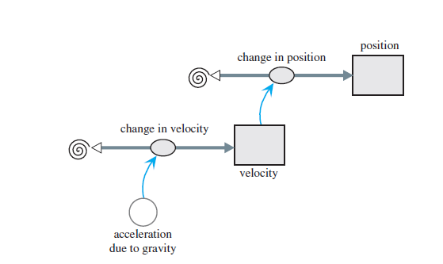
Diagram of motion of ball thrown straight up

Slide 20
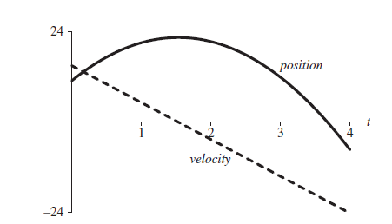
Graph of velocity (m/s) and position (m) of ball versus time (s)

Slide 21
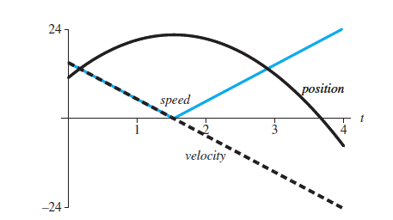
Graph of velocity (m/s), position (m), and speed (m/s) of ball versus time (s)

Slide 22
Force and Motion Model involving friction
Kinetic friction, or drag, is a force. This force between objects is in the opposite direction to a moving object and tends to slow motion. Thus, kinetic friction dampens motion of an object.
When an object moves through a fluid, such as air or water, the fluid friction is a function of the object’s velocity. For example, the faster we pedal a bicycle, the harder it is for us to do so. As our velocity increases, so does the friction of the air on our bodies

Slide 23
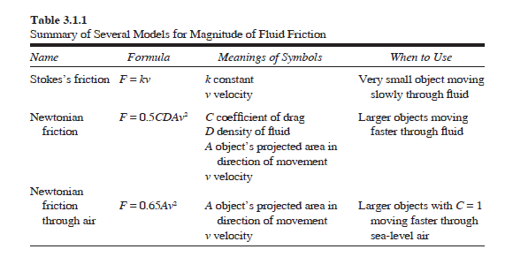
Different models for fluid friction

Slide 24
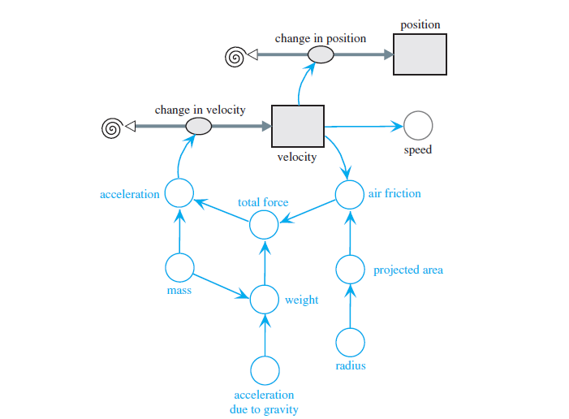
Diagram for motion of ball under influence of air friction

Slide 25
Equation Set for friction during fall model
mass = 0.5 kg
acceleration_due_to_gravity = –9.81 m/s2
radius = 0.05 m
weight = mass * acceleration_due_to_gravity
projected_area = 3.14159 * radius^2
air_friction = –0.65 * projected_area * velocity * ABS(velocity)
total_force = weight + air_friction
acceleration = total_force/mass
change_in_velocity = acceleration
change_in_position = velocity
speed = ABS(velocity)
velocity(0) = 0 m/s
velocity(t) = velocity(t – Δt) + (change_in_velocity) * Δt
position(0) = 400 m
position(t) = position(t – Δt) + (change_in_position) * Δt

Slide 26
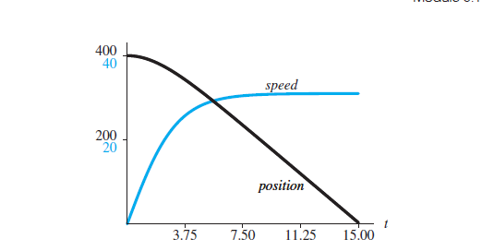
Graph of position (m) and speed (m/s) of object versus time (s) under influence of friction

Slide 27
Modeling Skydive
For simplicity, we consider someone jumping out of a stationary helicopter at 2000 m (about 6562 ft), and we ignore changes in air density.
The model for a skydive out of a helicopter has two phases.
For our model, the main difference in these two phases is the projected area in the direction of motion, down.
One where the person is in a free fall
The crosssectional area of a jumper in the stable arch position with arms arched back and legs bent at the knees is approximately 0.4 m2 (about 4.3 ft2).
The other after the parachute opens, when the larger surface area results in more air resistance.
Parachutes vary in their designs, but 28 m2 (about 301 ft2) is a reasonable value.
We trigger the pull of the ripcord by the height (position) above the ground, say, 1000 m (about 3281 ft).
Thus, the diagram contains a converter/variable (position_open) for this quantity and nectors/arrows from position to position_open and from position_open to projected_area.

Slide 28
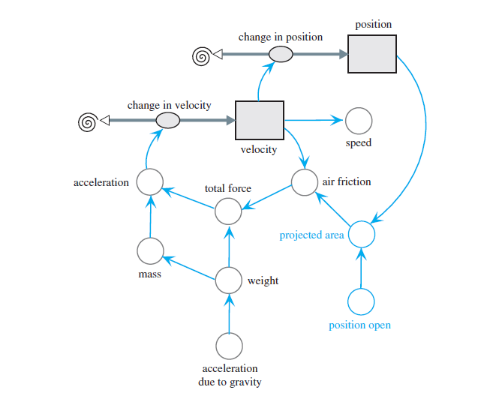
Modeling Skydive
if (position > position_open)
projected_area ← 0.4
else
projected_area ← 28
Diagram of skydiver’s motion under influence of air friction

Slide 29
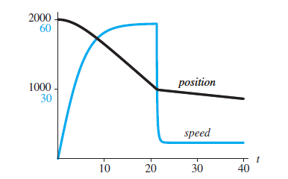
Position (m) and speed (m/s) versus time (s) of skydiver

Slide 30
SYSTEM DYNAMICS MODELS WITH INTERACTIONS
Competition is the struggle between individuals of a population or between species for the same limiting resource.
If one individual (species) reduces the availability of the resource to the other, we term that type of competition exploitative, or resource depletion. This interaction is indirect and may involve removal of the resource or denial of living space.
If there is direct interaction between individuals (species), where one interferes with or denies access to a resource, we term that competition interference. In this form, there may be physical contests for territory or resource.

Slide 31
Competition
In this situation, we can model the number of deaths of each species as being proportional to its population size and the population size of the other species.
Δ(deaths of WTS) = wBW, where w is a WTS death proportionality constant
Δ(deaths of BTS) = bWB where b is a BTS death proportionality constant

Slide 32
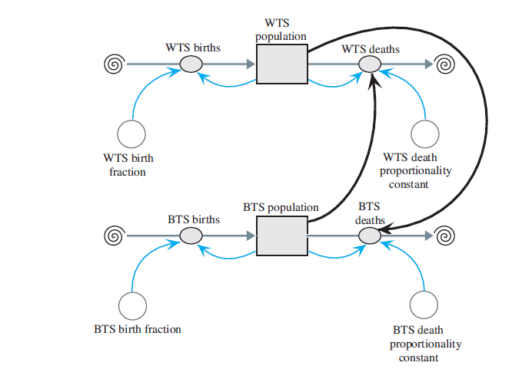
Model diagram of competition of species

Slide 33
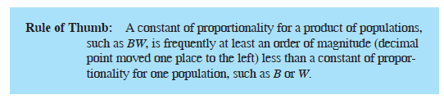
Equation Set
BTS_population(0) = 15
BTS_birth_fraction = 1
BTS_births = BTS_birth_fraction * BTS_population
BTS_death_proportionality_constant = 0.20
BTS_deaths = (BTS_death_proportionality_constant * WTS_population) * BTS_population
WTS_population(0) = 20
WTS_birth_fraction = 1
WTS_births = WTS_population * WTS_birth_fraction
WTS_death_proportionality_constant = 0.27
WTS_deaths = (WTS_death_proportionality_constant * BTS_population) * WTS_population

Slide 34
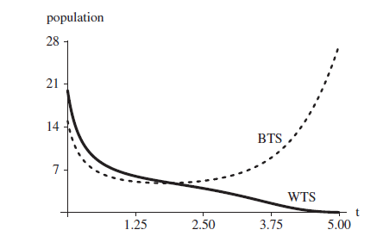
Graph of population change of BTS and WTS over time

